Slide 1
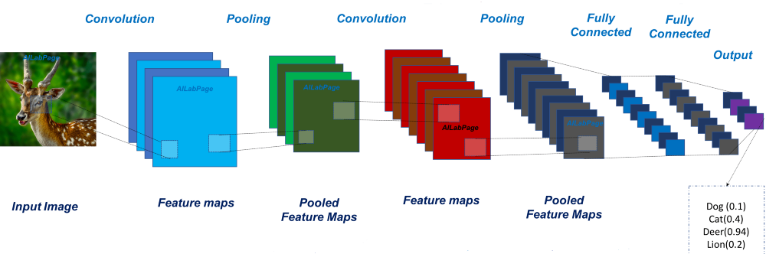

CNN Image classification
Introdution of Convolutional Neural Networks(CNN)
CNN Component
Convolution Layer
Filter
Activation function
Pooling Layer
Fully Connected Layer
Practice description

Slide 2
Introdution of Convolutional Neural Networks(CNN)
Introdution of Convolutional Neural Networks(CNN)

Slide 3
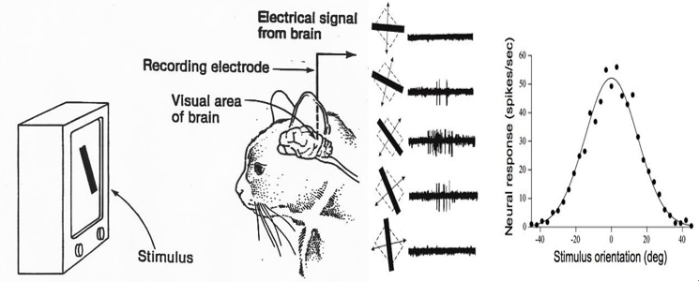
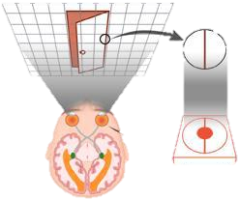
In the 1950s, Hubble and Wiesel found that the local receptive field of nerve cells in the visual cortex overlapped with each other to form the entire field of vision.
Introdution of Convolutional Neural Networks(CNN)

Slide 4
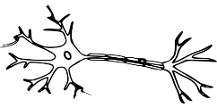
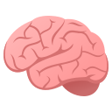
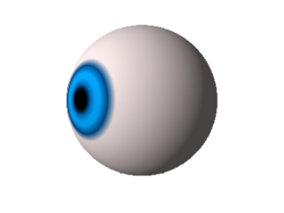
CNN is based on how neurons work in the visual cortex
Introdution of Convolutional Neural Networks(CNN)
Deer !
Notes:
10

Slide 5
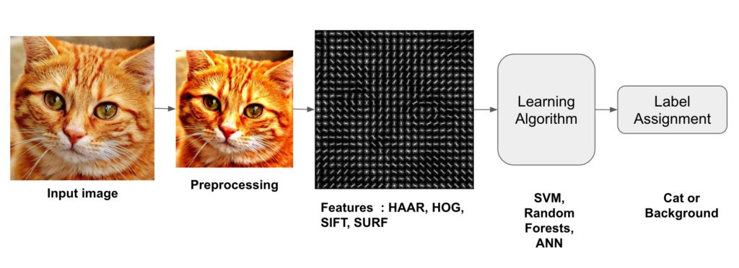
Difference between Traditional Image Classification and CNN Image Classification
Introdution of Convolutional Neural Networks(CNN)
CNN
CNN can do both feature extraction and classification.
Notes:
11

Slide 6
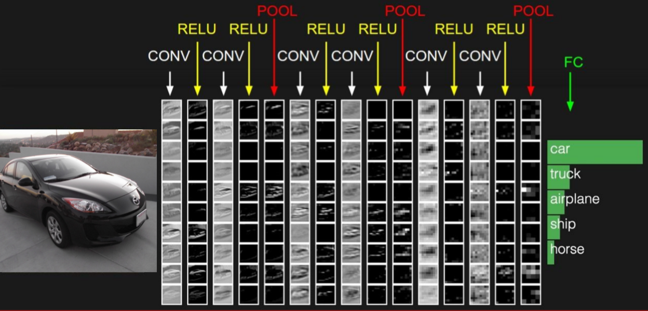
CNN Component
Introdution of Convolutional Neural Networks(CNN)
Convolution Layer
Filter
Activation function
Pooling Layer
Fully Connected Layer

Slide 7
Introdution of Convolutional Neural Networks(CNN)
CNN Component
Convolution Layer - Filter
Convolution Layer
Filter
Activation function
Pooling Layer
Fully Connected Layer

Slide 8
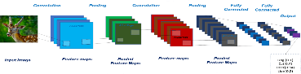
Each filter extracts different characteristics
CNN Component
Convolution Layer - Filter
edge
horizontal line
?
?
filter1
filter2
filter3
filter4

Slide 9
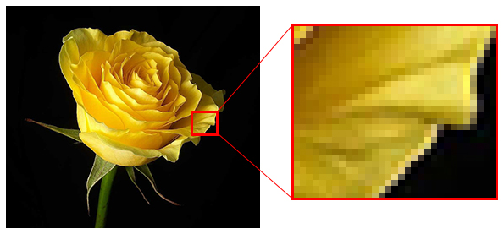
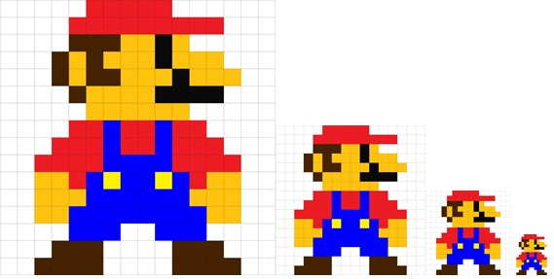
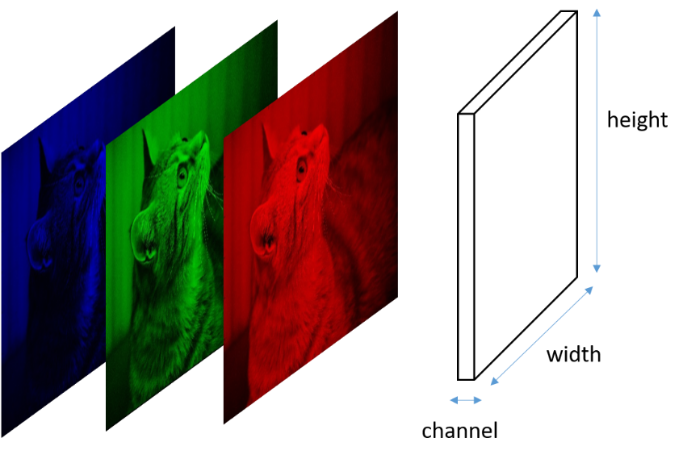
computer image is consist of pixcel and every pixcel has 3 channel which is RGB
CNN Component
Convolution Layer - Filter
0~255
0~255
0~255

Slide 10
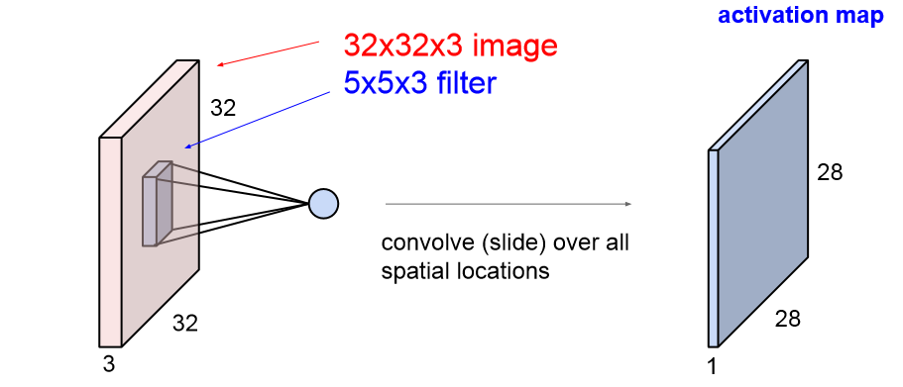
How filter works
CNN Component
Convolution Layer - Filter
each filter makes one map

Slide 11
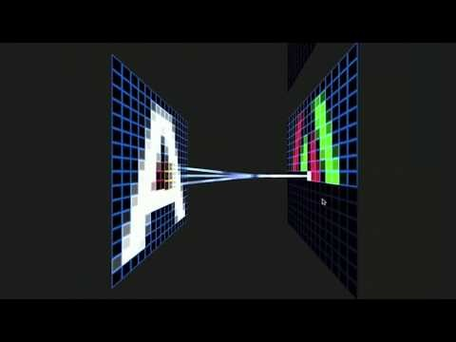
Convolutional Neural Network Visualization
CNN Component
Convolution Layer - Filter

Slide 12
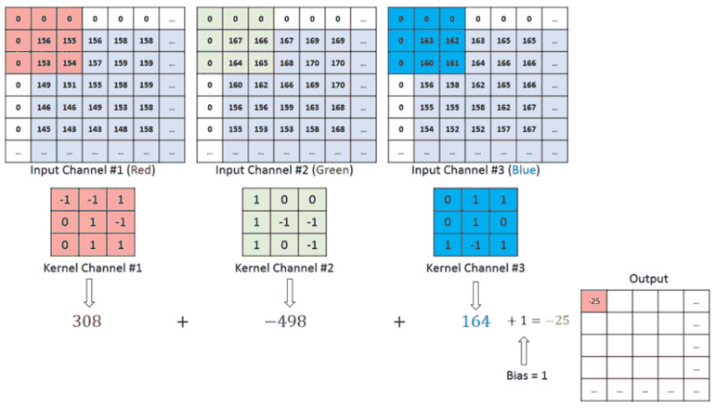

Process of calculating filters in the Convolution Layer
CNN Component
Convolution Layer - Filter
B
G
R
3x3x3 filter

Slide 13

CNN Component
Convolution Layer - Filter
Process of calculating filters in the Convolution Layer
B
G
R
3x3x3 filter

Slide 14
CNN Component
Convolution Layer - Filter
Stride and Padding
Stride
-How many will you move?
Padding
-How much image will be reduced?
-overcome Loosing information on corners of the image
0 | 0 | 0 | 0 | 0 | 0 | 0 | 0
0 |  |  |  |  |  |  | 0
0 |  |  |  |  |  |  | 0
0 |  |  |  |  |  |  | 0
0 |  |  |  |  |  |  | 0
0 |  |  |  |  |  |  | 0
0 |  |  |  |  |  |  | 0
0 | 0 | 0 | 0 | 0 | 0 | 0 | 0

Slide 15
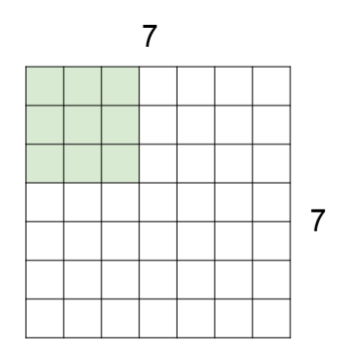
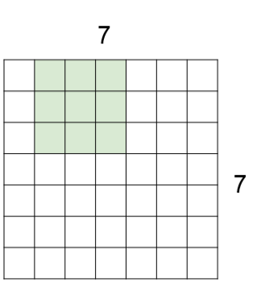
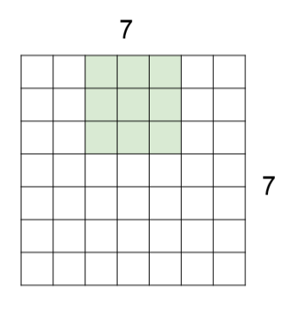
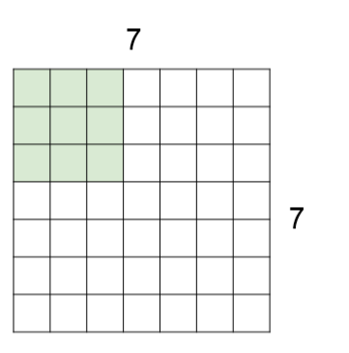
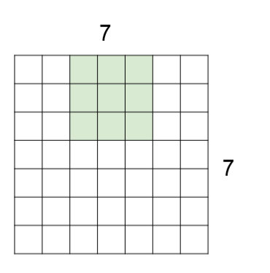
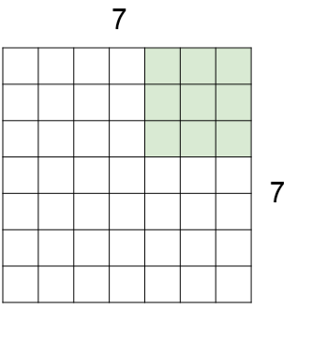
CNN Component
Convolution Layer - Filter
Calculation of Stride Output
stride = 1
stride = 2

Slide 16
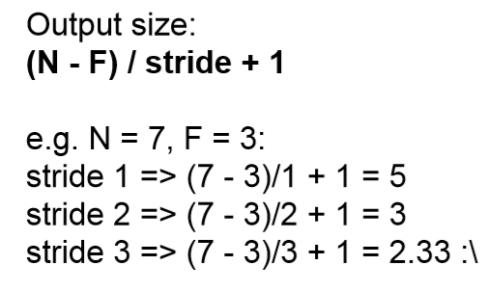
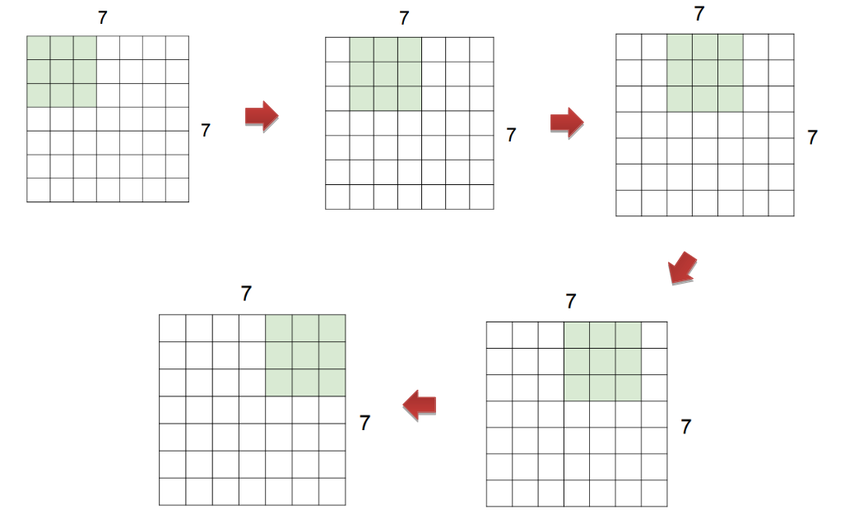
CNN Component
Convolution Layer - Filter
Calculation of Stride Output
stride = 1
output
5
5
doesn’t fit!

Slide 17
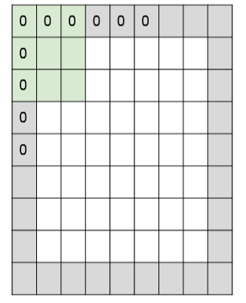
CNN Component
Convolution Layer - Filter
Calculation of Stride&Padding Output
Zero Padding
F
Output Size:
(N-F+2P)/Stride+1
e.g. N=7, F=3
Stride=1, Padding=1 → (7-3+2*1)/1+1= 7
Stride=2, Padding=1 → (7-3+2*1)/2+1= 4
Stride=2, Padding=2 → (7-3+2*2)/2+1= 5
Stride=2, Padding=3 → (7-3+2*2)/2+1= 7
N
7
7
P

Slide 18
CNN Component
Convolution Layer - Filter
Calculation of Stride&Padding Output
Depth = Number of filters
F
Num of filters =5 → 4 X 4 X 5
Num of filters =10 → 4 X 4 X 10
Num of filters =15 → 4 X 4 X 15
N
7
7
P
e.g. N=7, F=3
Stride=2, Padding=1 → (7-3+2*1)/2+1= 4

Slide 19
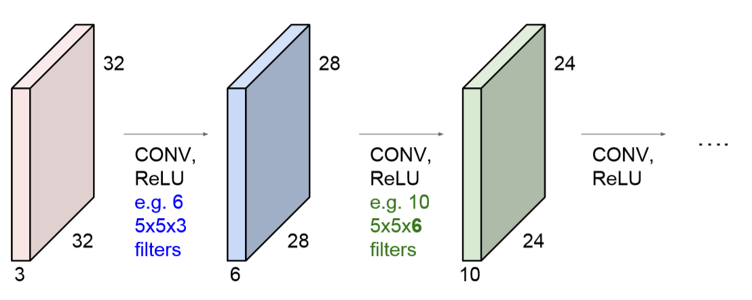
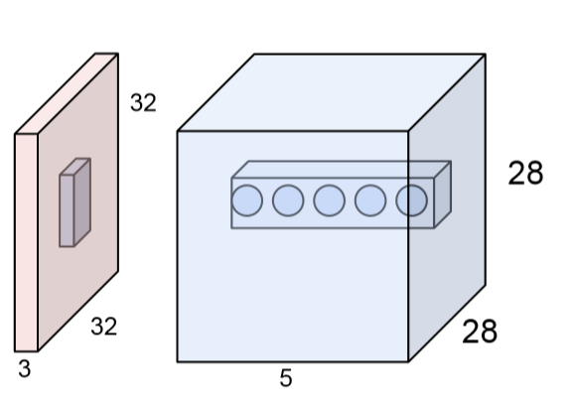
CNN Component
Convolution Layer - Filter
Output of each layer is input of next Layer
Stride =1
Padding=0
Stride =1
Padding=0
(32-5+2*0)/1+1 = 28
(28-5+2*0)/1+1 = 24
applying different filter from the same spatial location
Notes:
전통적인 이미지 분류 기술과 CNN이 가장 다른 점은 모델 스스로가 학습하여 적절한 features를 검출하기 위한 convolution filter 값을 찾아간다는 것
즉, 모델 스스로가 해당 분석 대상의 특징 점을 분석할 수 있게 학습

Slide 20
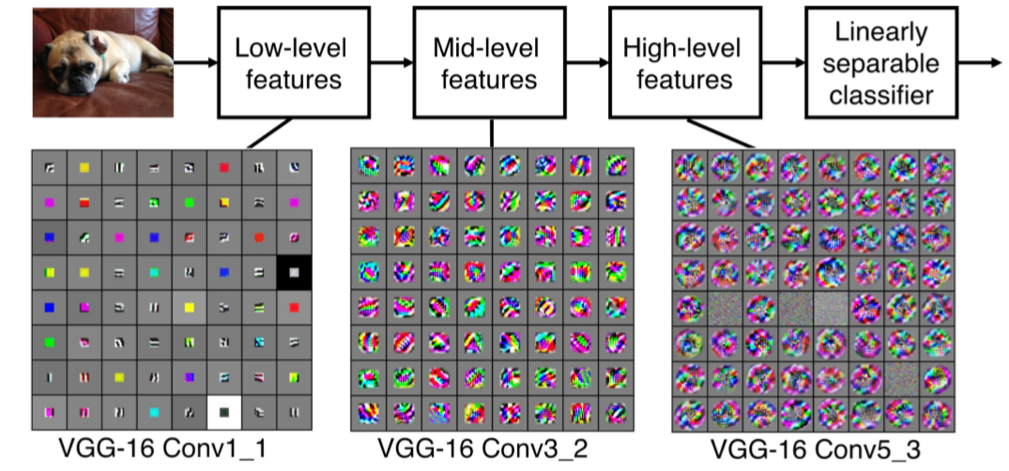
CNN Component
Convolution Layer - Filter
Extract features from low to high Levels through layers
edge
corner, blobs
more resemble concepts

Slide 21
Introdution of Convolutional Neural Networks(CNN)
CNN Component
Convolution Layer – Activation function
Convolution Layer
Filter
Activation function
Pooling Layer
Fully Connected Layer

Slide 22

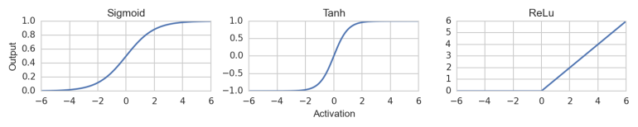
CNN Component
Convolution Layer – Activation function
Extract required features more clearly
Gradient vanishing problem

Slide 23
The Output from the filter goes through the Activation fuction
CNN Component
Convolution Layer – Activation function
B
G
R
3x3x3 filter
Activation function

Slide 24
Introdution of Convolutional Neural Networks(CNN)
CNN Component
Pooling Layer
Convolution Layer
Filter
Activation function
Pooling Layer
Fully Connected Layer
Notes:
전통적인 이미지 분류 기술과 CNN이 가장 다른 점은 모델 스스로가 학습하여 적절한 features를 검출하기 위한 convolution filter 값을 찾아간다는 것
즉, 모델 스스로가 해당 분석 대상의 특징 점을 분석할 수 있게 학습

Slide 25
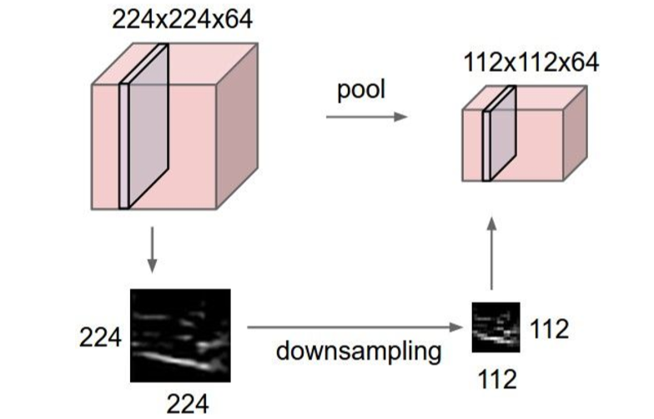

CNN Component
Pooling Layer
Downsampling the output

Slide 26
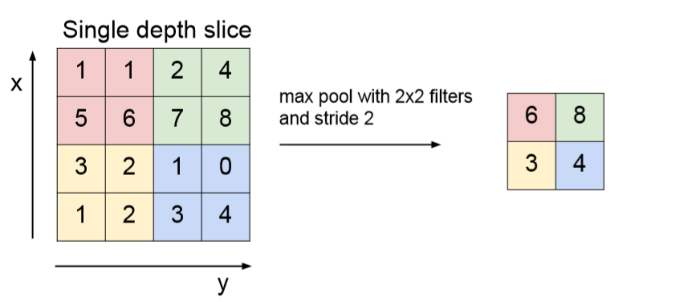
CNN Component
Pooling Layer
Max Pooling
Extract the largest value from the region
※ do not have any overlab
※ pooling layer : padding x

Slide 27
Introdution of Convolutional Neural Networks(CNN)
CNN Component
Fully Connected Layer
Convolution Layer
Filter
Activation function
Pooling Layer
Fully Connected Layer

Slide 28

CNN Component
Fully Connected Layer
Stretch out all pixels and Predict value

Slide 29
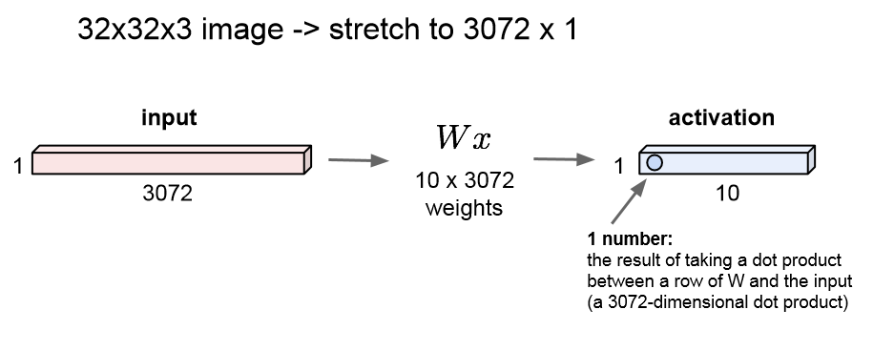
CNN Component
Fully Connected Layer
Stretch all of pixels out

Slide 30
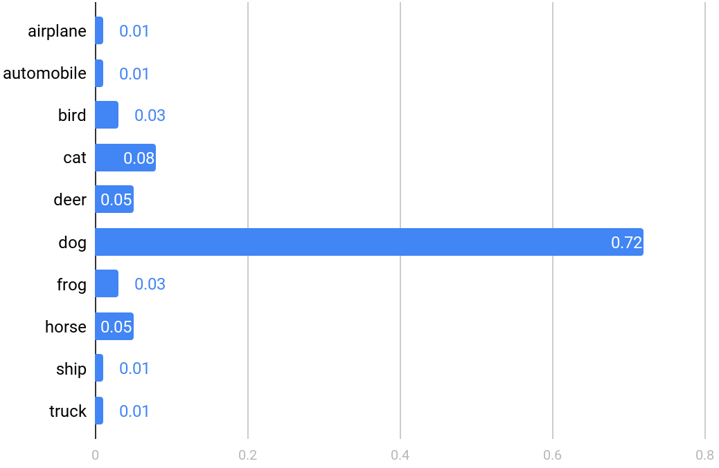
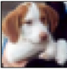
CNN Component
Fully Connected Layer
MaxPooling
2x2 filter
2 stride
MaxPooling
2x2 filter
2 stride
Input
3@32x32
Conv1
64@28x28
5x5 filter
1 stride
Conv2
64@10x10
5x5 filter
1 stride
Fc3
384
Fc4
192

Slide 31
Practice description
Practice description

Slide 32
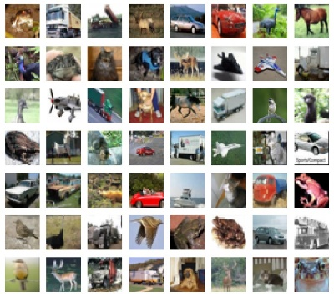
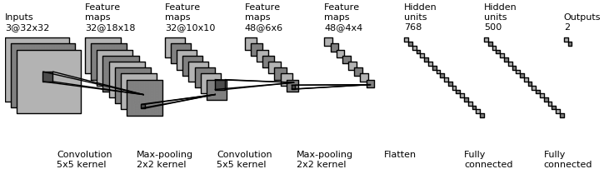
Practice description
Create CNN Model with Keras
Classification

Slide 33
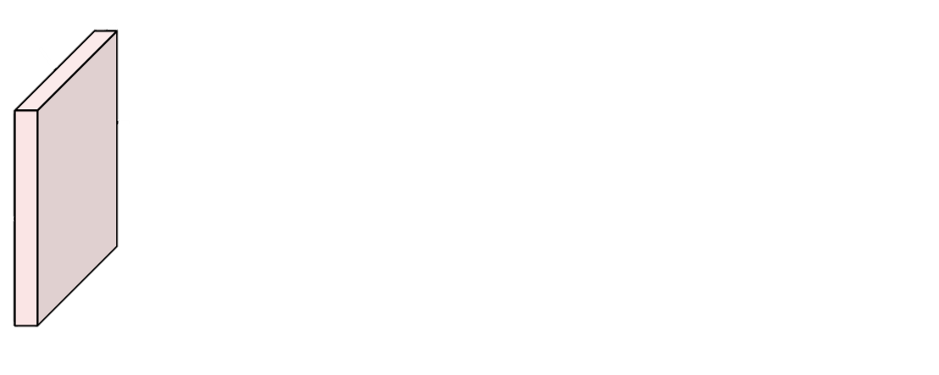
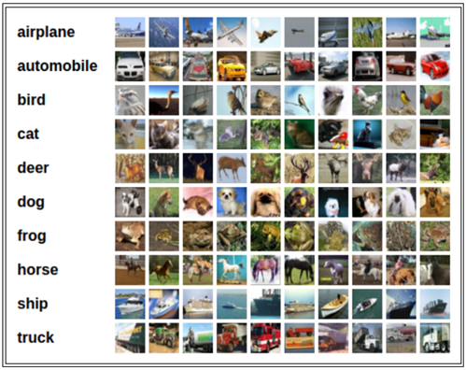
Practice description
Data : CIFAR10
32
32
3
CIFAR10 consist of 60000 32X32 colour images
There are 50000 training images and 10000 test images.
There are 10 classes

Slide 34
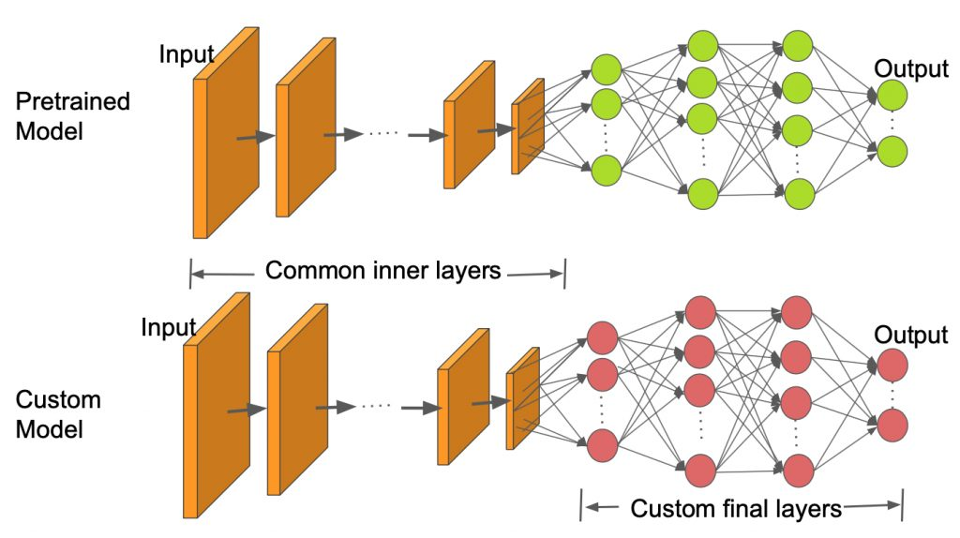
Transfer Learning
Transfer Learning
VGG16
Image Agumentation
Practice description

Slide 35
Transfer Learning
Transfer Learning

Slide 36
Transfer Learning
Transfer Learning is to reuse a pretrained model for new task

Slide 37
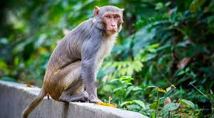
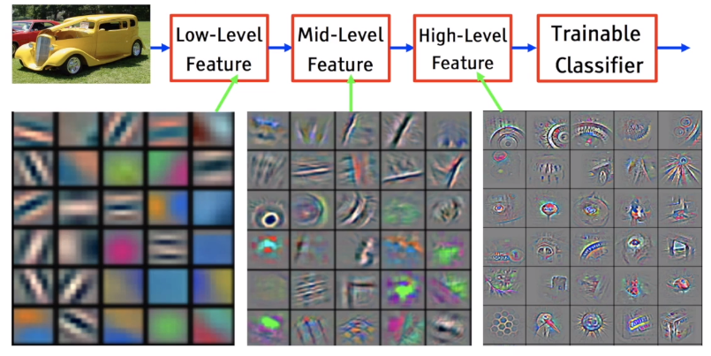
Transfer Learning
A pretrained model can share features that can be extracted
New Class
e.g. monkey
Notes:
전통적인 이미지 분류 기술과 CNN이 가장 다른 점은 모델 스스로가 학습하여 적절한 features를 검출하기 위한 convolution filter 값을 찾아간다는 것
즉, 모델 스스로가 해당 분석 대상의 특징 점을 분석할 수 있게 학습

Slide 38
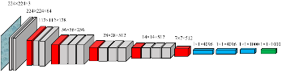
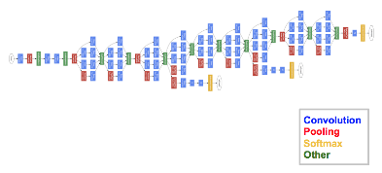
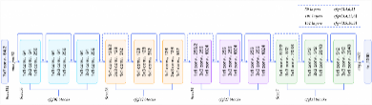
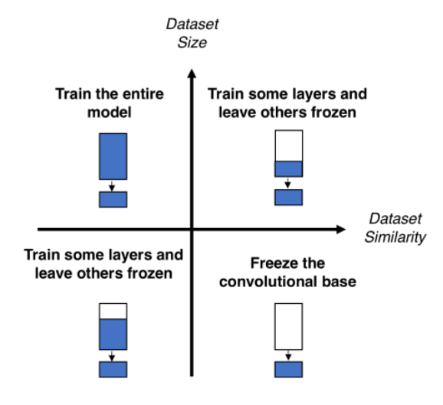
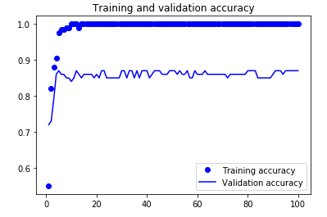
Transfer Learning
Transfer Learning Process
Select a pre-trained model e.g. VGG, Inception, ResNet, …
Classify your problem according to the Size-Similarity Matrix
Fine-tune your model
Notes:
전통적인 이미지 분류 기술과 CNN이 가장 다른 점은 모델 스스로가 학습하여 적절한 features를 검출하기 위한 convolution filter 값을 찾아간다는 것
즉, 모델 스스로가 해당 분석 대상의 특징 점을 분석할 수 있게 학습

Slide 39
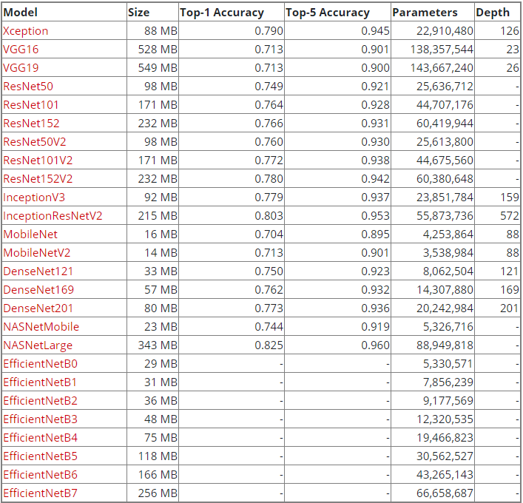
Transfer Learning
1. Select a pre-trained model
All the model available on Keras
Top-1 accuracy
: highest probability answers match the expected answer
Top-5 accuracy
: one of 5 highest probability answers matches the expected answer
e.g
Tiger: 0.4
Dog: 0.3
Cat: 0.1
Lynx: 0.09
Lion: 0.08
Bird: 0.02
Bear: 0.01

Slide 40
Transfer Learning
1. Select a pre-trained model
using pretrained model
In Tensorflow, use TF-Slim library
AlexNet, VGGNet, ResNet, Inception, MobileNet
https://github.com/tensorflow/models/tree/master/research/slim
In Pytorch, use TORCHVISION.MODELS library
AlexNet, VGG, ResNet, Inception v3, GoogLeNet, MobileNet v2, ….
https://pytorch.org/docs/stable/torchvision/models.html

Slide 41
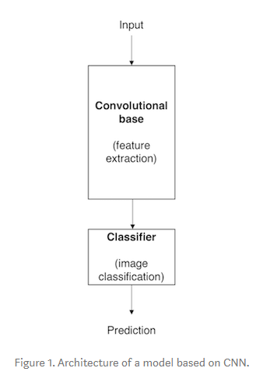
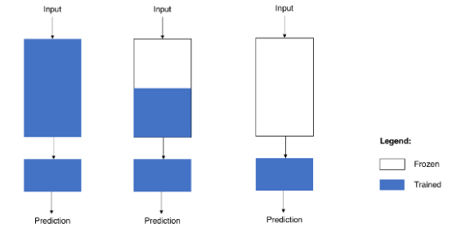
Transfer Learning
2. classify your problem according to the Size-Similarity Matrix
Transfer Learning strategy
Stratege1
Train the entire model
Stratege2
Train some layers and leave the others frozen
Stratege3
Freeze the convolutional base

Slide 42
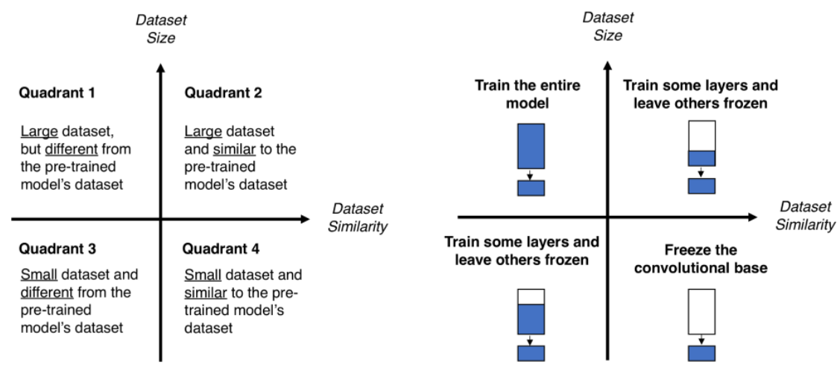
Transfer Learning
2. classify your problem according to the Size-Similarity Matrix

Slide 43
Transfer Learning
3. Fine-tune your model
Lower learning rate when finetuning
1/10 of original learning rate is good starting point

Slide 44
VGG16
VGG16

Slide 45
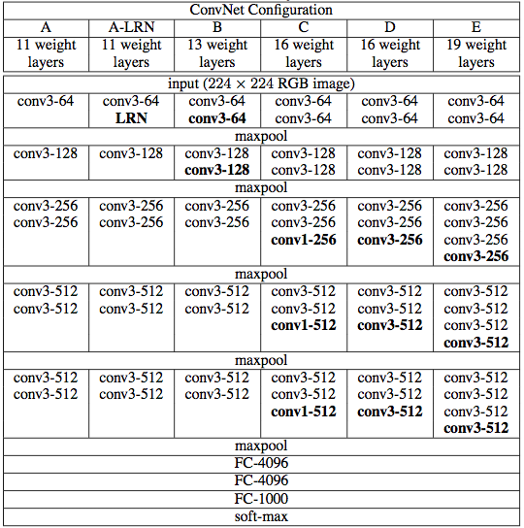
Transfer Learning
VGGNet
Designed by Oxford (VGG16, VGG19)
Simonyan, Karen, and Andrew Zisserman. "Very deep convolutional networks for large-scale image recognition." arXiv preprint arXiv:1409.1556 (2014).
VGG16
VGG19

Slide 46

Transfer Learning
Leads VGG19 to Second place in 2014 ILSVR (ImageNet Large Scale Visual Recognition Challenge)
Simple structure, Good performance

Slide 47


Transfer Learning
Small filters, Deeper networks
increase
Only use 3x3 conv filter
stride 1, padding 1 → same output size
$$\frac{1}{2}$$
$$\frac{1}{2}$$
$$\frac{1}{2}$$
increase non-linearities
decrease in the number of weights
$$\frac{1}{2}$$
$$\frac{1}{2}$$

Slide 48


Transfer Learning
Increase non-linearities
Deep learning is learned based on nonlinear transformation

Slide 49

Transfer Learning
Increase non-linearities
3 x 3
filter
stride1
3 x 3
filter
stride1
5 x 5
filter
stride1

Slide 50
Transfer Learning
Decrease in the number of weights
3 x 3
filter
stride1
3 x 3
filter
stride1
18
5 x 5
filter
stride1
25

Slide 51

Transfer Learning
VGG16 Architecture

Slide 52
Image Agumentation
Image Agumentation

Slide 53

Image Agumentation
Image Agumentation
Solve data lack problems and increase diversity

Slide 54







Image Agumentation
Original
Image Agumentation
Rotation
Shifting
Flipping
Adding Noise
Blurring

Slide 55
Practice description
Practice description

Slide 56


Practice description
Fine-tune VGG16 Model with Keras
1,500 cat images / 1,500 dog images
Image Agumentation

Slide 57

Practice description
VGG16 Model is pretrained with IMAGENET
1000 class
More than 14 million images
More than 20,000 categories

Slide 58


Practice description
Fine-tune VGG16 Model with Dog and Cat Dataset
Dog
or
Cat
More than 14 million images
More than 20,000 categories

Slide 59
Practice description
Fine-tune VGG16 Model with Dog and Cat Dataset

Slide 60
Thank You

Slide 61


Slide 62



10 = (x -5)
10 – (x -5) = 차이
10 – (x -5) = y

Slide 63

B
[[[] ,[] ,[] ],
[[] ,[] ,[] ],
[[] ,[] ,[] ]]
G
R
[[ , , ],
[ , , ],
[ , , ]]

Slide 64




2000
1000
2 3 4 5 6 7 8 9 10 11 12 13 14 15 16 17 18 19
filter bias
filter bias
filter bias

Slide 65
The Output from the filter goes through the Activation fuction
CNN Component
Convolution Layer – Activation function
Activation function
X

